Slide 1
Chap 5: Neural Nets
BCS2313: Artificial Intelligence Techniques

Slide 2
Neural Networks Architecture

Slide 3
Neural Networks Architecture
Single layer networks – Only have one layer of weight
eg:

Slide 4
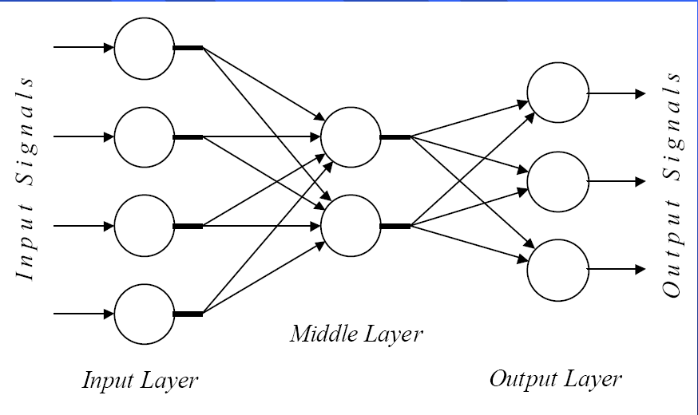
Neural Networks Architecture
Multi layer network – have 2 or more weight layer
It consist of a input layer 1 or more middle layer and a output layer

Slide 5
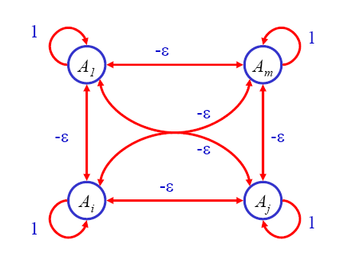
Neural Networks Architecture
Competitive layer networks – close loop networks
eg:

Slide 6
Activation Function
Usually, don’t just use weighted sum directly
Apply some function to the weighted sum before it is used (e.g., as output)
Call this the activation function
Step function, Sigmoid function, Linear Function, Gaussian Function

Slide 7
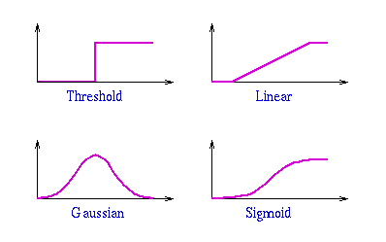
Basic Structure of Neural Network

Slide 8
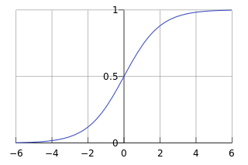
Sigmoid Activation Function
The math of some neural nets requires that the activation function be continuously differentiable.
A sigmoid function is a mathematical function having an "S" shape (sigmoid curve).

Slide 9
Sigmoid Example
Input: (3, 1, 0, -2)
0.3
-0.1
2.1
-1.1
Input: (2, 10, 0, 3) – What is the output?

Slide 10
Basic Structure of Neural Network
A two weight layer, feedforward network
Two inputs, one output, one ‘hidden’ unit
Input: (3, 1)
0.5
0.75
-0.5
What is the output?

Slide 11
Neural Network Application Development
Methodology
Data collection
Data normalisation
Neural network design
Neural network training
Testing

Slide 12
Data collection
Data collection – Collect the chosen data to be used as a training sample.
Sepal length | Sepal width | Petal length | Petal width | Iris Class
5.7 | 4.4 | 1.5 | 0.4 | Iris-setosa
5.4 | 3.9 | 1.3 | 0.4 | Iris-setosa
6.1 | 2.8 | 4.7 | 1.2 | Iris-versicolor
6.4 | 2.9 | 4.3 | 1.3 | Iris-versicolor
6.1 | 3 | 4.9 | 1.8 | Iris-virginica
6.4 | 2.8 | 5.6 | 2.1 | Iris-virginica

Slide 13
Data collection
Attributes | Minimum | Maximum
Sepal length | 4.3 | 7.9
Sepal width | 2 | 4.4
Petal length | 1 | 6.9
Petal width | 0.1 | 2.5
Sepal length | Sepal width | Petal length | Petal width | Iris Class
5.8 | 2.5 | 3.9 | 1.1 | ?

Slide 14
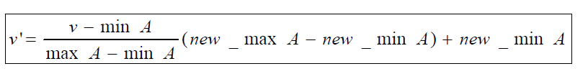
Data normalisation
Data normalisation – normalisation process applied to the selected data.
Max- Min normalization formula
Example: We want to normalize data to range of the interval [0,1].
We put: new_max A= 1, new_minA =0.

Slide 15
Neural network design
4 input attributes and 1 decision
4 input nodes and 1 output nodes

Slide 16
Neural network training
Back-propagation training will be used to train the networks

Slide 17
The backpropagation learning process using error from the output and propagate back to previous layer for weight changes.
Output layer (Y) error is multiplication of error value with activation function derivation.

Slide 18
Calculate the hidden layer error by multiply the derivative of the activation function with summation of multiplication for output layer error and hidden layer weight

Slide 19
The network weights are updated with following delta weight changes
Where,

